Slide 1
Topic: Controlling a computer over a network
Presentation Content:
Default Interface: Allow Remote Control
Control Remote Computer Interface
Options:
+ General.
+ Security.
+ Miscellaneous.
+ File Transfer.
Diagnostic.
Proxy Settings.

Slide 2
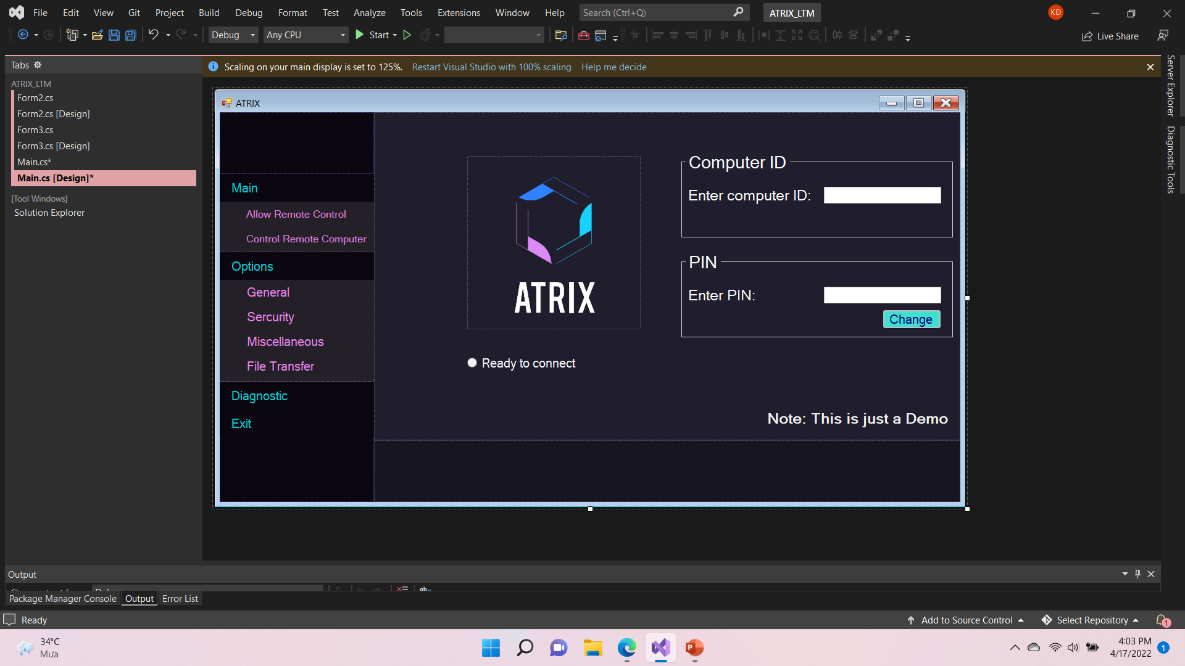
Default Interface
Notes:
The design of the group's remote desktop application is heavily inspired by the CloudBerry Remote Desktop app - a product of MSP360
The default interface will be like this
This interface will contain information and functions about security
Computer ID and PIN: The Computer ID is a unique identifier for the computer. The PIN is a password that is used to verify the identity of the computer.
3 main features of the application:
Remote computer: This feature allows you to control another computer remotely.
Chat: This feature allows you to chat with other users of the application.
Transfer file: This feature allows you to transfer files between two computers.

Slide 3



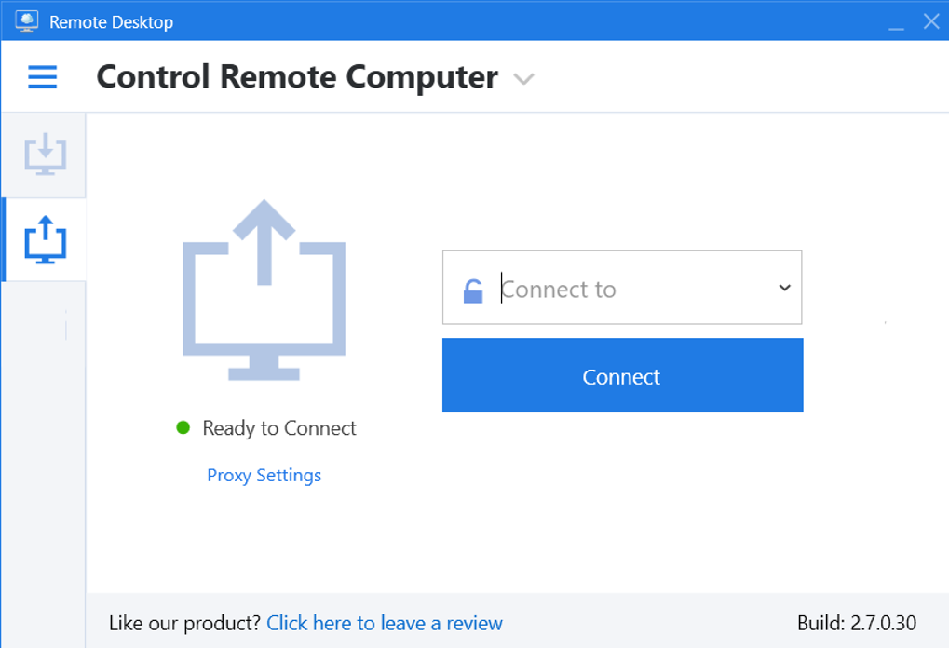

Notes:
The next interface will be CONTROL REMOTE COMPUTER, the user can enter the ID of the computer they want to connect to and press Connect.

Slide 4


Slide 5




GROUP 5
General
Options - General
Sercurity
Options – Sercurity
BẮT ĐẦU THUYẾT TRÌNH
Miscellaneous
Options - Miscellaneous
GROUP NAME
File Transfer
Options – File Transfer
OPTIONS

Slide 6

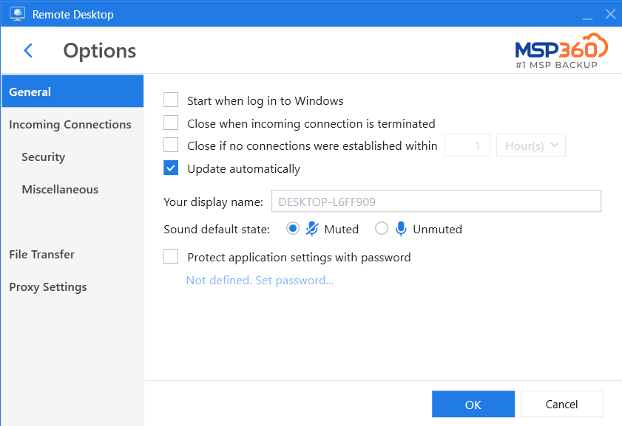
Options – General
Môn học thuyết trình: Lập trình mạng căn bản
Notes:
Option-General: This is the section of the application where the user can set general preferences.
Start when log in to Windows: This setting allows the application to start automatically when the user logs in to Windows.
Set the device name when connecting: This setting allows the user to set the name of the device that will be displayed when connecting to another device.
The default microphone status when setting up a connection: This setting allows the user to set the default microphone status when setting up a connection.
Use a password to protect the application: This setting allows the user to set a password to protect the application from unauthorized access.

Slide 7

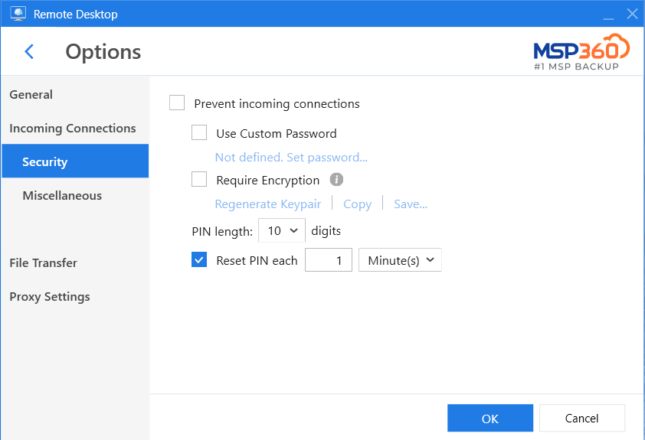
Options – Sercurity
Notes:
Option-IncomingConnections Security: This is the section of the application where the user can set security preferences for incoming connections.
Prevent incoming connections: This setting prevents other users from connecting to the user's computer.
Use a custom password instead of a PIN: This setting allows the user to set a custom password instead of a PIN to protect their computer from unauthorized access.
Require encryption to connect: This setting requires all connections to be encrypted, which helps to protect the data that is transmitted between the two computers.
PIN settings: This section of the application allows the user to set preferences for the PIN that is used to connect to the computer.

Slide 8
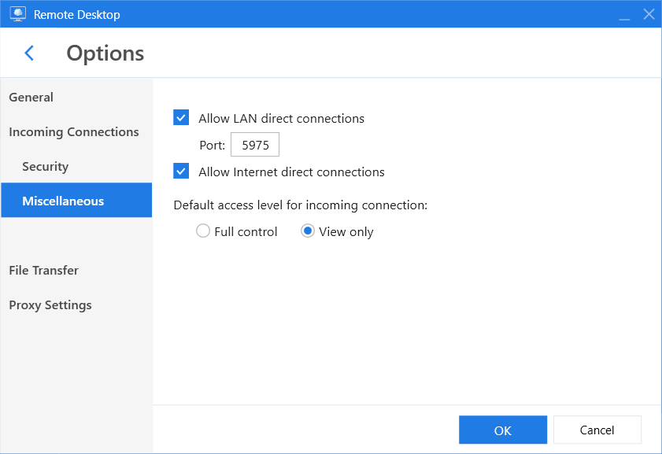
Options - Miscellaneous
Allow Lan connect.
Allow Internet connect.
Access level.
GROUP 5
Notes:
Option-IncomingConnections Miscellaneous: This is the section of the application where the user can set miscellaneous preferences for incoming connections.
Allow LAN connection: This setting allows other users on the same local area network (LAN) to connect to the user's computer.
Allow Internet connection: This setting allows other users on the internet to connect to the user's computer.
Access level: This setting allows the user to set the access level for incoming connections. The access level can be set to full control or view only.

Slide 9
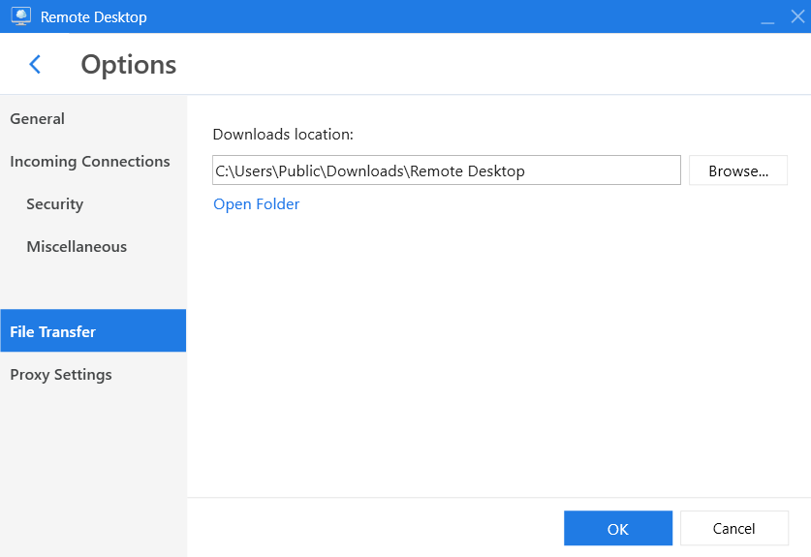
File Transfer
Set up a path to store files
Options – File Transfer
Notes:
Option-FileTransfer: This is the section of the application where the user can set preferences for the file transfer feature.
Path to store files: This is the location where the files that are transferred between the two computers will be stored.

Slide 10
DIAGNOSTIC
Diagnostic
DIAGNOSTIC

Slide 11




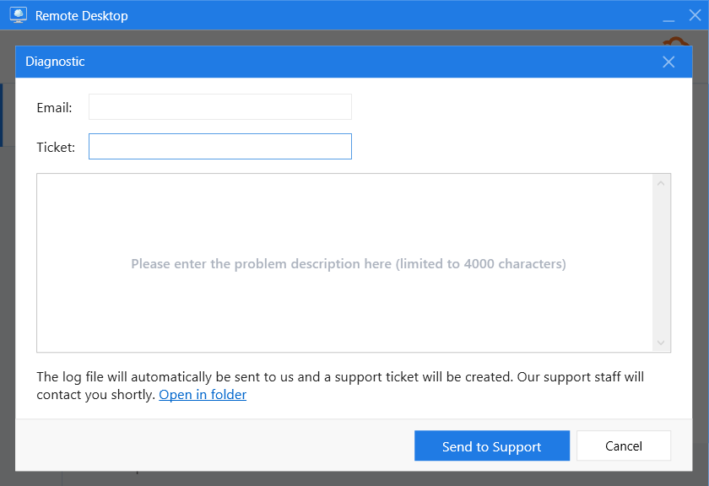


Diagnostic

Slide 12

THANKS FOR WATHCHING !

